Slide 1
Types of Network Attacks
Information Security

Slide 2
Types of Network Attacks
What is Attack
Types of Network Attacks
  Reconnaissance Attack
  Passive Attack
  Active Attack
  Distributed Attack
  Insider Attack
  Phishing Attack
  Back Door
  Password Attacks

Slide 3
Types of Network Attacks
Types of Network Attacks
  IP Address Spoofing Attack
  ARP (Address Resolution Protocol) Spoofing Attack
  DNS (Domain Name System) Spoofing Attack
  SYN Flood Attack
  Sniffer Attack
  Man-In-The-Middle (MITM) Attack
  Denial of Service (DoS) Attack
  Distributed Denial of Service (DDoS) Attack
  SQL Injection Attack

Slide 4
Types of Network Attacks
IP Address Spoofing Attack
  In this kind of attack an adversary changes the source address of packet so receiver assumes that the packet is coming from another valid IP address.
  In IP address spoofing, IP packets are generated with fake source IP addresses in order to masquerade as other systems
  This technique is typically used to bypass the firewall rules.
Notes:
Masquerade: ma·skuh·reid

Slide 5
Types of Network Attacks
ARP (Address Resolution Protocol) Spoofing Attack
  Address Resolution Protocol (ARP)
  Used by TCP/IP on an Ethernet network to find the MAC address of another device
  The IP address and the corresponding MAC address are stored in an ARP cache for future reference
  An attacker could alter the MAC address in the ARP cache so that the corresponding IP address would point to a different computer

Slide 6
Types of Network Attacks
DNS (Domain Name System) Spoofing Attack
  Domain Name System
  Domain Name System (DNS) is the basis for name resolution to IP addresses today
  DNS Cache Poisoning
  Like ARP poisoning, tricks the target machine into resolving domain names to incorrect IP addresses
  Changing the hosts file to redirect traffic to a spoofed website

Slide 7
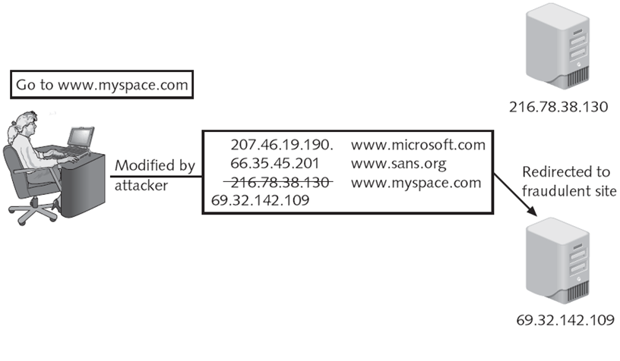
Types of Network Attacks
Notes:
Fraudulent: fraa·juh·luhnt
dishonest, cheating, corrupt, criminal, illegal, unlawful

Slide 8
Types of Network Attacks
SYN Flood Attack
  TCP handshake: SYN, SYN/ACK, ACK
  Each SYN sent burdens the server because it has to calculate the SYN/ACK and remember to wait for the ACK
  The attack occurs when the attacker sends large number of SYN packets to the victim, forcing them to wait for replies that never come.
  The third part of the TCP three-way handshake is not executed.
  Since the host is waiting for large number of replies, the real service requests are not processed, bringing down the service.

Slide 9
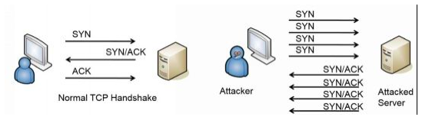
Types of Network Attacks
SYN Flood Attack

Slide 10
Types of Network Attacks
Sniffer Attack
  A sniffer is an application that can capture network packets. Sniffers are also known as network protocol analyzers.
  While protocol analyzers are really network troubleshooting tools, they are also used by hackers for hacking network.
  If the network packets are not encrypted, the data within the network packet can be read using a sniffer.

Slide 11
Types of Network Attacks
Sniffer Attack
  Sniffing refers to the process used by attackers to capture network traffic using a sniffer.
  Once the packet is captured using a sniffer, the contents of packets can be analyzed.
  Sniffers are used by hackers to capture sensitive network information, such as passwords, account information etc.

Slide 12
Types of Network Attacks
Man-In-The-Middle (MITM) Attack
  In this attack an adversary captures data from middle of transmission and changes it, then send it again to the destination.
  Receiving person thinks that this message came from original source.
  Man-in-the-Middle (MITM) attacks are also known as "session hijacking attacks", which means that the attacker hijacks a authorized user's session to control the communication.

Slide 13
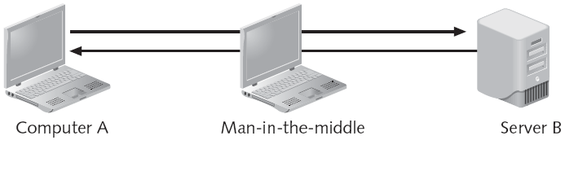
Types of Network Attacks
Man-In-The-Middle (MITM) Attack

Slide 14
Types of Network Attacks
Denial of Service (DoS) Attack
  The idea of DOS attack is to reduce the quality of service offered by server, or to crash server with heavy work load.
  Denial-of-service (DoS): Attacker sends large number of connection or information requests to a target
  Target system cannot handle successfully along with other, valid service requests
  May result in system crash or inability to perform ordinary functions

Slide 15
Types of Network Attacks
Distributed Denial of Service (DDoS) Attack
  Distributed denial-of-service (DDoS): coordinated stream of requests is launched against target from many locations simultaneously
  In Distributed Denial of Service (DDoS), an intruder compromise one computer and make it Distributed Denial of Service (DDoS) master.
  Using this Distributed Denial of Service (DDoS) master, the intruder identifies and communicates with other systems that can be compromised.

Slide 16
Types of Network Attacks
Distributed Denial of Service (DDoS) Attack
  Then the intruder installs Distributed Denial of Service (DDoS) tools on all compromised systems.
  With a single command, the intruder instructs the compromised computers to launch flood attacks against the target server.
  Here thousands of compromised computers are flooding or overloading the resources of the target server preventing the valid users from accessing the services offered by the server.

Slide 17
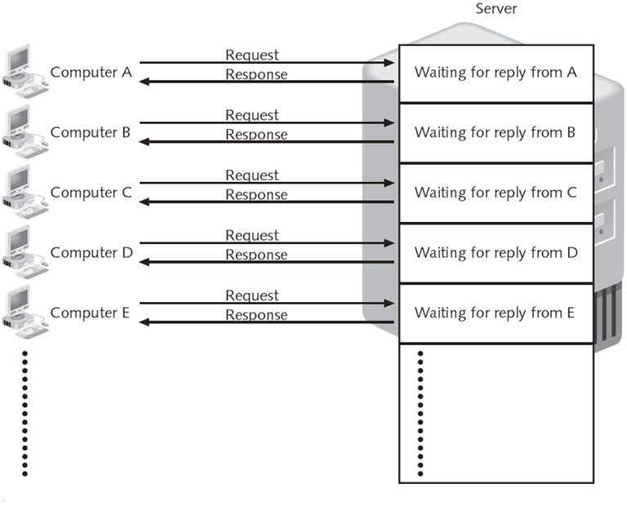
Types of Network Attacks
Distributed Denial of Service (DDoS) Attack

Slide 18
Types of Network Attacks
SQL Injection Attack
  SQL injection attack is another type of attack to exploit applications that use client-supplied data in SQL statements.
  Here malicious code is inserted into strings that are later passed to database application for parsing and execution.
  The common method of SQL injection attack is direct insertion of malicious code into user-input variables that are concatenated with SQL commands and executed.
Notes:
Parsing: syntax analysis

Slide 19
Types of Network Attacks
SQL Injection Attack
  Following example shows the simplest form of SQL injection.
  "select * from UserInfo where UserID = '" + UserID + "'";
  If the user fills the field with correct information of his UserID (F827781), after the script execution the above SQL query will look like
  SELECT * FROM UserInfo WHERE UserID = 'F827781'

Slide 20
Types of Network Attacks
SQL Injection Attack
  Consider a case when a user fills the field with the below entry.
  F827781; drop table UserInfo--
  After the execution of the script, the SQL code will look like
  SELECT * FROM UserInfo WHERE UserID = ' F827781';drop table UserInfo--
  This will ultimately result in deletion of table UserInfo.

